Slide 1


Slide 2


Web Scraping
→ Project Title :
Internet Movie Data Base
IMDB Data analysis

Slide 3
Project Done By
T.Saikumar
&
A.Naveen

Slide 4
Libraries Used
→ Numpy
→ Pandas
→ Regex
→ Requests
→ Beautiful Soup
→ Matplotlib
→ Seaborn

Slide 5
Problem Statement
From this Scraping I found few things mentioned below
Highest No. of movies released in which year
Highest Gross collected movies.
How much rating was given for large No. of movies
Highest movies on which genre
Highest voted movies

Slide 6
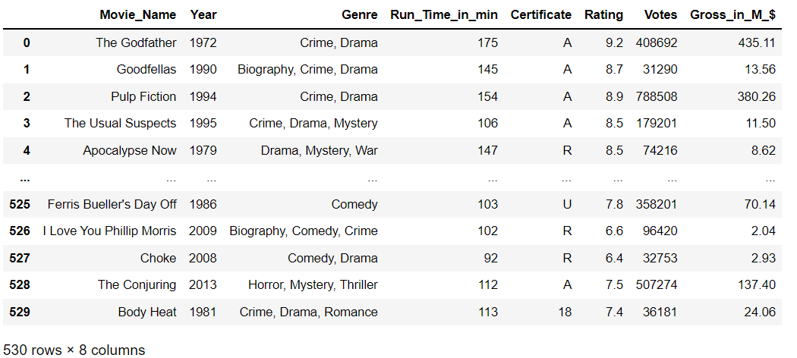
DATA FRAME

Slide 7
DATA VISUALIZATION
DATA VISUALIZATION IS THE GRAPHICAL REPRESENTATION OF INFORMATION AND DATA PROVIDED.

Slide 8
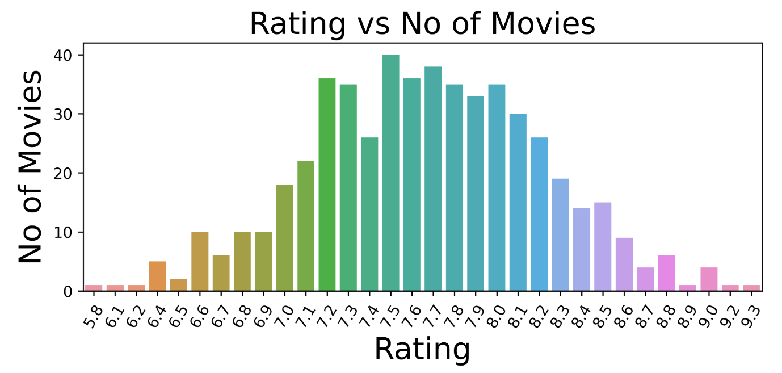
UNI-VARIATE ANALYSIS

Slide 9
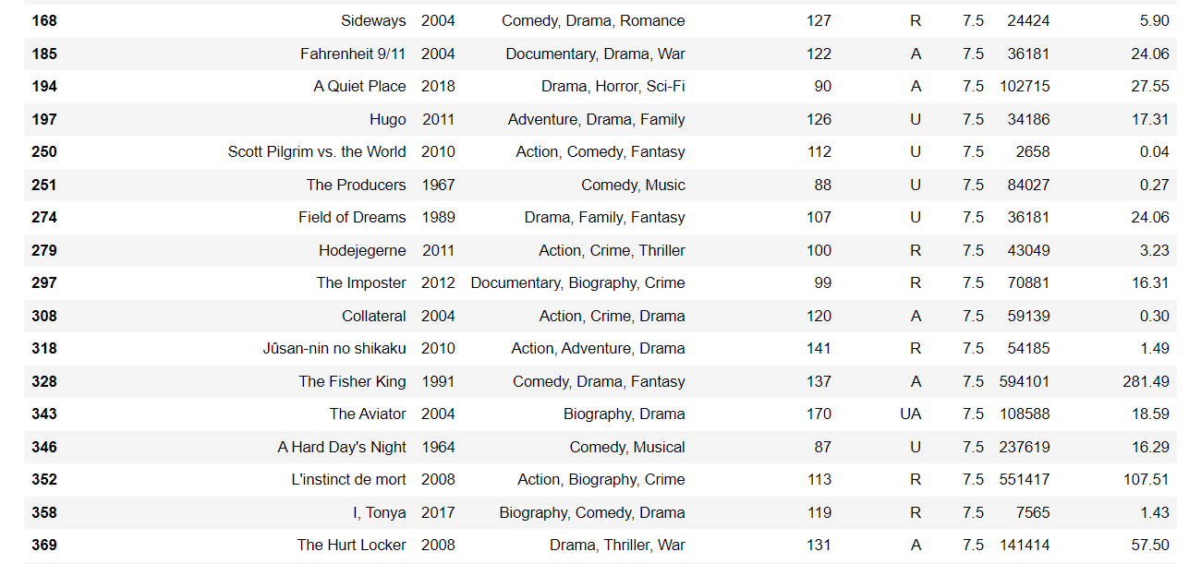
Analyzed data from the above plot

Slide 10
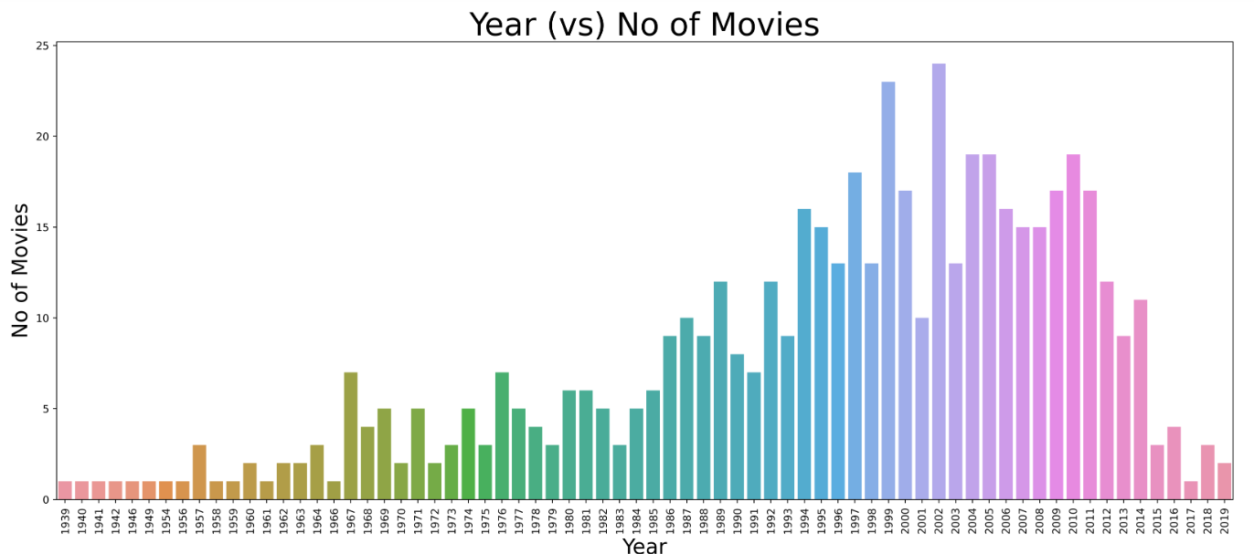
Release year vs no.of movies released

Slide 11
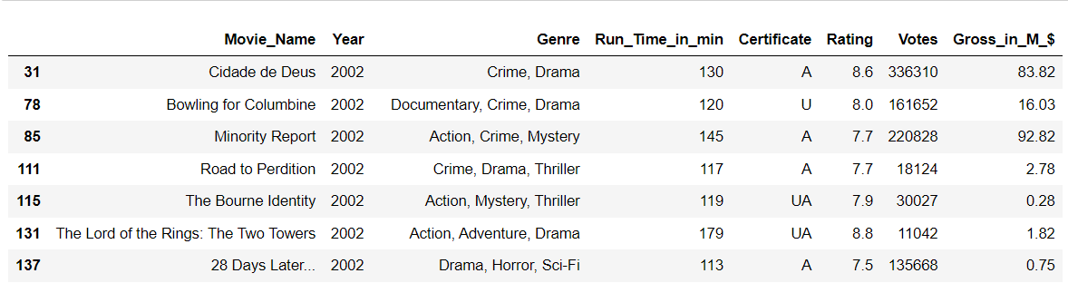
ANALYSED DATA FROM THE ABOVE PLOT:

Slide 12
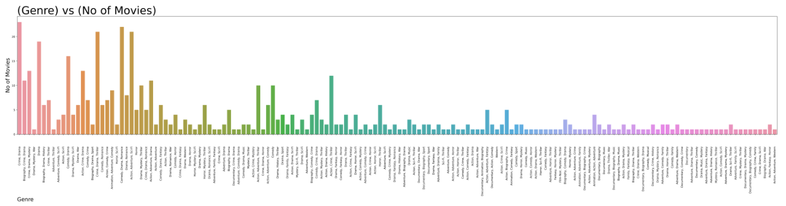
Counter plot on Genre column

Slide 13
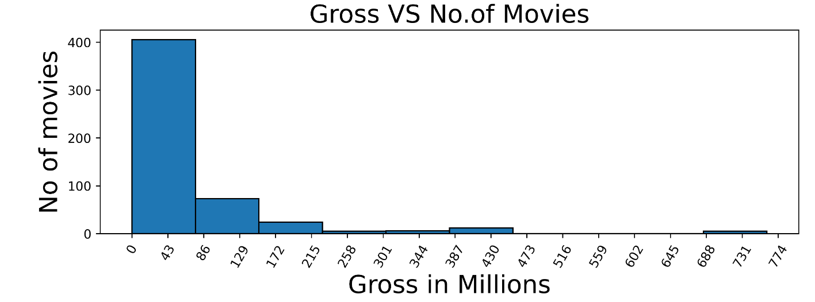
Gross in Millions

Slide 14
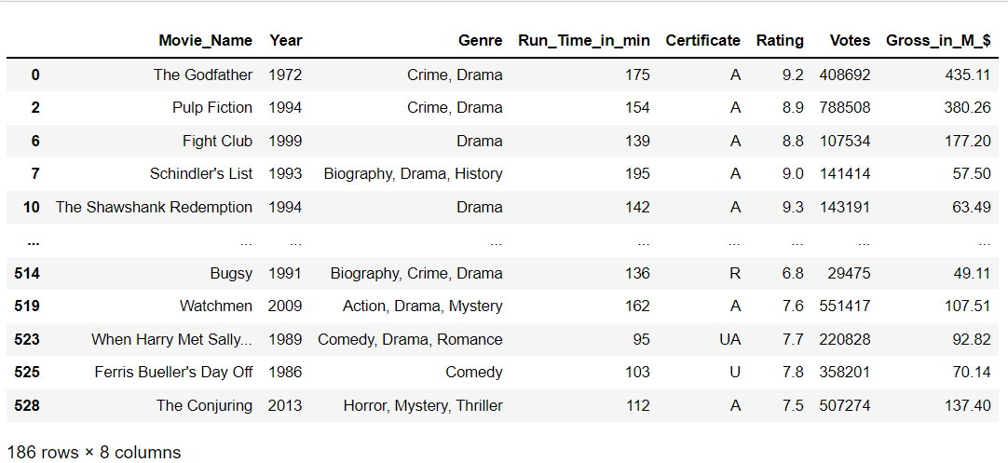
ANALYSED DATA FROM THE ABOVE PLOT:

Slide 15
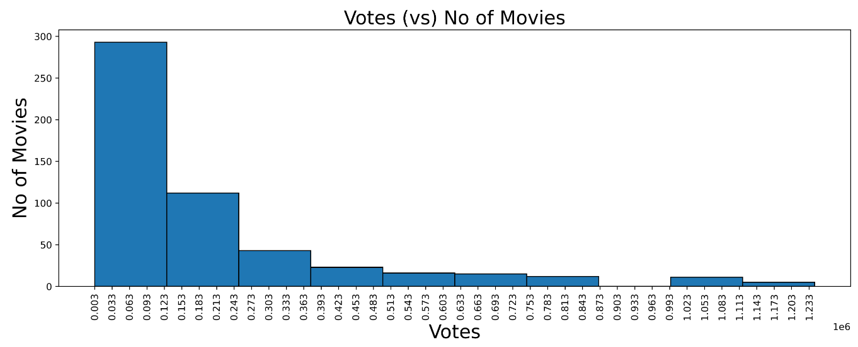
Histogram on Votes

Slide 16
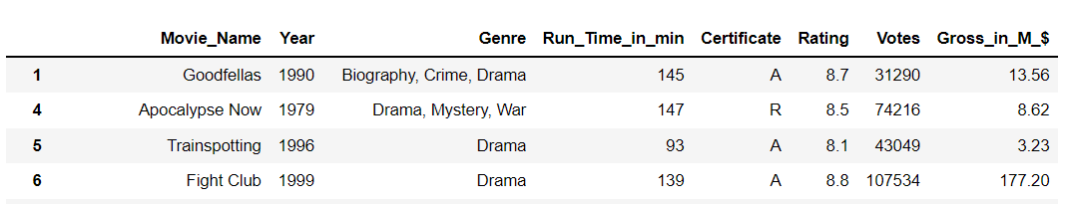
ANALYSED DATA FROM THE ABOVE PLOT:

Slide 17
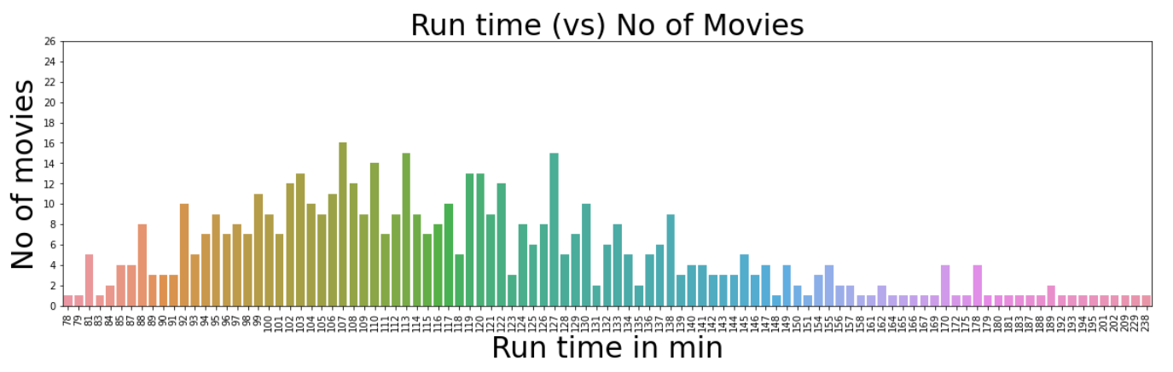
Count plot on Run Time in min

Slide 18
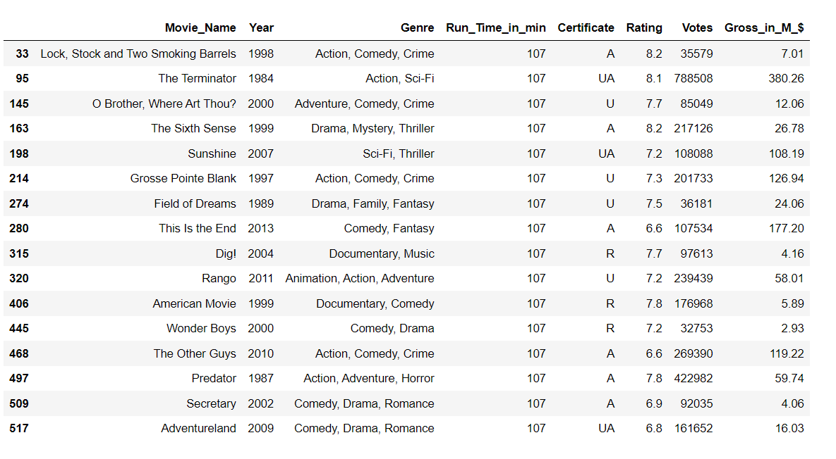
ANALYSED DATA FROM THE ABOVE PLOT:

Slide 19
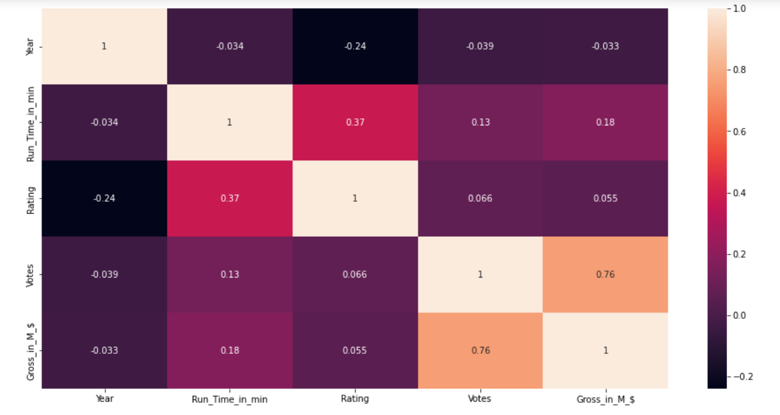
Multi variate analysis

Slide 20
Conclusion
most of the movies were rated 7.5.
most of the movies were released in the year of 2002.
most of the movies were collected 43 Millions.
Most of the movies got voted b/w 3000 & 123000
Running time for Most of the movies were 107 min
When the Votes are increasing Gross is increasing

Slide 21


